Slide 1
SPARK BASICS
3. Spark SQL

Slide 2
Learning Outcomes
Upon completion of this lesson, students will be able to:
Understand Spark SQL
Understand DataFrames
Apply Spark SQL syntaxes

Slide 3
Spark SQL
Spark SQL is a Spark module for structured data processing.
Unlike the basic Spark RDD API, the interfaces provided by Spark SQL provide Spark with more information about the structure of both the data and the computation being performed.
Spark SQL includes a cost-based optimizer, columnar storage ,and code generation to make queries fast

Slide 4
DataFrames
Basic data structure in Spark SQL
A DataFrame is a Dataset organized into name columns
Equivalent to a table in a relational database or a data frame in R/Python
The DataFrame API is available in Scala, Java, Python, and R

Slide 5
Starting Point: SparkSession
The entry point into all functionality in Spark is the SparkSession class
To create a basic SparkSession, use SparkSession.builder
from pyspark.sql import SparkSession
spark = SparkSession \
.builder \
.appName(“Example”) \
.config(“spark.some.config.option”, “some-value”) \
.getOrCreate()

Slide 6
Create DataFrame
DataFrames can be created by SparkSession object
DataFrames can be created from
An existing RDD
Spark data sources
Hive table
# spark is an existing SparkSession
df = spark.createDataFrame(an_existing_rdd)
df = spark.read.load(an_input_file)

Slide 7
Create DataFrame
Think of a DataFrame being implemented with an RDD of Row objects
Nicest way to create Rows: create a custom subclass for your data
from pyspark.sql import Row
MovieYear = Row(‘movie’, ‘year’)
data = [ MovieYear(‘The Godfather’, 1972),
MovieYear(‘Forrest Gump’, 1994),
MovieYear(‘Up’, 2009) ]
sc = spark.sparkContext
rdd = sc.parallelize(data) # create rdd
df = spark.createDataFrame(rdd) # create DataFrame from rdd of Rows

Slide 8
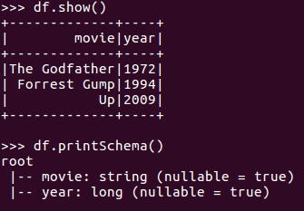
Viewing DataFrames
DataFrames are table-like and have a fixed schema
.show() is a convenient debugging/testing output method
Displays the content of the DataFrame to stdout
Notes:
show() method will print the DataFrame as a table structure
printSchema() method will print the schema of the DataFrame

Slide 9
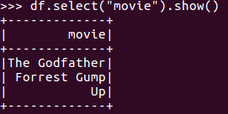
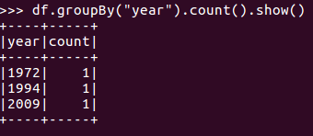
DataFrame Operations
Very SQL-like
# Select only the “movie” column
# Count movies by year
Notes:
With DataFrame we can use SQL like query commands (i.e. select, groupBy, count) for specific operations

Slide 10
Column Expressions
2 different equivalent ways to refer to a DataFrame column
Indexing: df[‘year’]
By attribute: df.year
The preferred way is the first one (indexing)
won’t break with column names that are also attributes on the DataFrame class

Slide 11
Column Expressions
# Select people older than 21
df.where(df[‘year’] > 2000) # works
df.filter(df.year> 2000).show() # works
df.where(‘year’ > 2000) # fails
‘year’>2000 is a bool, not a column expression

Slide 12
Column Expressions
Because you can refer to a column with its name in a string, this is ambiguous:
df.where(df[‘movie’] == ‘Up’)
df.where(df[‘movie’] == ‘year’)
Are ‘Up’ and ‘year’ columns or string literals? Be explicit:
df.where(df[‘movie’] == functions.lit(‘Up’))
df.where(df[‘movie’] == df[‘year’] )

Slide 13
Column Expressions
pyspark.sql.functions module has functions for lots of useful calculations in column expressions
In core-Spark, we wrote Python functions that could have any logic
Spark SQL has only column expressions, so we are restricted to what they can do

Slide 14
UDFs
We can register a user defined function (UDF) from Python
But there is a speed penalty getting the data to/from Python
from pyspark.sql.functions import udf
def convert2float(x):
return float(x)
convert_udf = udf(convert2float, types.FloatType())
df = df.select(convert_udf(‘year’))

Slide 15
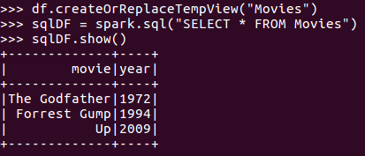
Running SQL Queries Programmatically
Run sql queries programmatically with SparkSession’s sql function
This function returns the result as a DataFrame
Notes:
In the example, using SparkSession’s sql function, we write a simple sql query to fetch all the rows of Movies dataframe

Slide 16
Sources
M. Armbrust, R. Xin, C. Lian, Y. Huai, D. Liu, J. Bradley, X. Meng, T. Kaftan, M. Franklin, A. Ghodsi and M. Zaharia. Spark SQL: Relational Data Processing in Spark. SIGMOD 2015, June 2015.
https://spark.apache.org/docs/latest/sql-programming-guide.html

